Slide 1
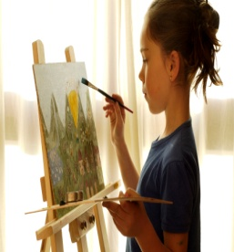
Wine and Design
Join us at the Hollywood Volunteer Rescue Squad, 43256 Rescue Lane
Friday, February 27, 2015
Fun begins at 6:30 p.m.
Cost is $45 and includes an instructor, canvas, paints, easel, brushes and aprons
Light refreshments will be served
To sign up go to: http://www.wineanddesign.com/location/leonardtown-md/home, go to the calendar, find the date and follow the instructions
Payment must be received in advance
Pass this on to your friends and family. Don't worry if you can't paint, it's a fun night out!
Any questions, please call Barbara Wible at 240-298-7443.

